Slide 1





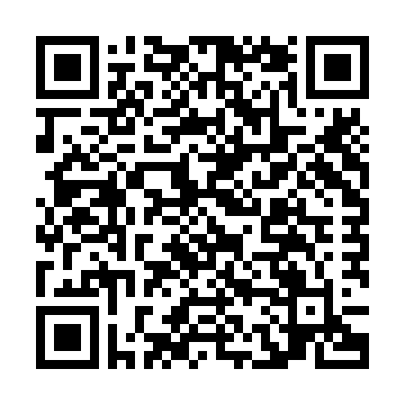

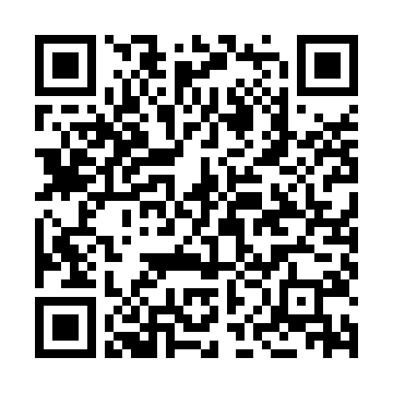

EMM can help with the stress of the holidays
Life is stressful enough without adding the holidays into the mix.
Get some relief with EMM.
Take advantage of Micron’s mobile capabilities and do work-related tasks on your smartphone.
Submit time off, approve POs, access your email, update your calendar, and much more.
EMM can’t help you out if you’re trying to find the perfect Christmas gifts at the mall, but it’s an easy way to help reduce some stress during the holiday season.
Submit the request form
Follow the
text prompts
Install apps from the Micron app store
Quick Enroll Guides
http://mobile/
©2016 Micron Technology, Inc. All rights reserved. Micron and the Micron logo are trademarks of Micron Technology, Inc.
All other trademarks are the property of their respective owners.
Icons made by xxxx xxxxxx from www.???????.com are licensed by CC 3.0 BY.

